Slide 1
Surface Stereo with Soft Segmentation
Michael Bleyer¹, Carsten Rother², Pushmeet Kohli²
¹Vienna University of Technology, Austria
²Microsoft Research Cambridge, UK
ICVSS 2010

Slide 2
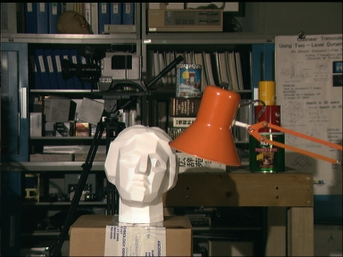
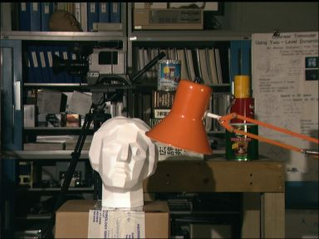
Dense Stereo Matching
(Left Image)
(Right Image)

Slide 3
Dense Stereo Matching
(Left Image)
(Right Image)
(Disparity Map)

Slide 4
Common Approaches
Reference image

Slide 5
Common Approaches
Assign pixels to disparity values
Reference image
Disparity map

Slide 6
Our Approach
Reference image

Slide 7
Our Approach
Assign pixels to 3D surfaces
Reference image
Surface map

Slide 8
Our Approach
Assign pixels to 3D surfaces
Surfaces implicitly define disparities
Reference image
Surface map
Disparity map

Slide 9
Our Approach
Assign pixels to 3D surfaces
Surfaces implicitly define disparities
Our approach simultaneously infers:
1. Which surfaces are present in the scene
2. Which pixels belong to which surface
Reference image
Surface map
Disparity map

Slide 10
Energy
Search an assignment of pixels to surfaces that minimizes an energy:
Surfaces: planes or B-splines.
Data Term:
Computes pixel dissimilarities; Penalty for occluded pixels
Smoothness Term:
Penalty on spatially neighboring pixels assigned to different surfaces
Soft Segmentation Term:
Penalty on inconsistencies with a given color segmentation
MDL Term:
Penalty on the number of surfaces
Curvature Term:
Penalty on disparity curvature

Slide 11
Energy
Contributions
Search an assignment of pixels to surfaces that minimizes an energy:
Surfaces: planes or B-splines.
Data Term:
Computes pixel dissimilarities; Penalty for occluded pixels
Smoothness Term:
Penalty on spatially neighboring pixels assigned to different surfaces
Soft Segmentation Term:
Penalty on inconsistencies with a given color segmentation
MDL Term:
Penalty on the number of surfaces
Curvature Term:
Penalty on disparity curvature

Slide 12
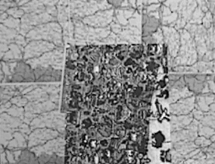
Soft Segmentation Term
Common segmentation-based methods:
Color segmentation of reference image
Assign each segment to a single surface
Fail if segment overlaps a disparity discontinuity.
Map reference image
Ground truth disparities
Result of hard segmentation method

Slide 13
Soft Segmentation Term
Our approach:
Prefer solutions consistent with a segmentation (lower energy).
Segmentation = soft constraint.
Result of hard segmentation method
Our result

Slide 14
Soft Segmentation Term
Segment

Slide 15
Soft Segmentation Term
Segment

Slide 16
Soft Segmentation Term
Segment
Subsegment

Slide 17
Soft Segmentation Term
Our term:
0 penalty if all pixels within subsegment assigned to the same surface
Constant penalty, otherwise
Segment
Subsegment

Slide 18
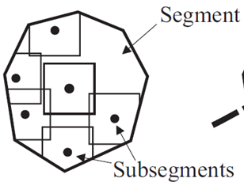
Soft Segmentation Term

Slide 19
Soft Segmentation Term

Slide 20
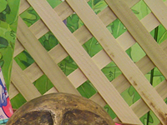
MDL Term
Simple scene explanation better than unnecessarily complex one.
Penalty on the number of surfaces.
Solution containing 5 surfaces cheaper than one with 100 surfaces.
Crop of the Cones image
Solution without our MDL term.
Our MDL term.

Slide 21
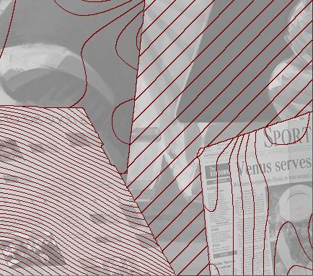
Curvature Term
Second order priors:
Difficult to optimize in disparity-based representation due to triple cliques [Woodford et al., CVPR08].
Our approach:
Curvature analytically computed from surface model.
Easy to optimize in surface-based representation (unary term).
Result without curvature term.
Result with curvature term.

Slide 22
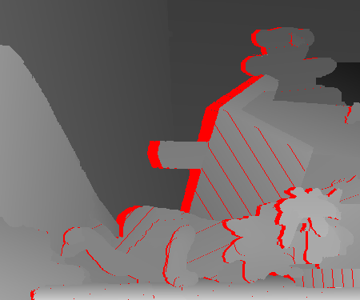
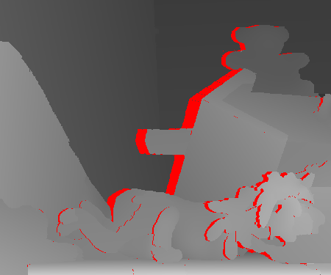
Improved Asymmetric Occlusion Handling
Uniqueness assumption violated for slanted surfaces:
Several pixels of the same surface correspond to a single pixel of the second view.
Our approach:
Pixels must not occlude each other if they lie on same surface.
Avoids wrongly detected occlusions at slanted surfaces.
Standard Occlusion Handling
Ours

Slide 23
Energy Optimization
Not easy – label set of infinite size!
Fusion move approach [Lempitsky et al., ICCV07]:
Current Solution

Slide 24
Energy Optimization
Not easy – label set of infinite size!
Fusion move approach [Lempitsky et al., ICCV07]:
Current Solution
Proposal

Slide 25
Energy Optimization
Not easy – label set of infinite size!
Fusion move approach [Lempitsky et al., ICCV07]:
Current Solution
Proposal
Fusion Result

Slide 26
Energy Optimization
Not easy – label set of infinite size!
Fusion move approach [Lempitsky et al., ICCV07]:
Current Solution
Proposal
Computing the “optimal” fusion move:
Recent work on sparse higher-order cliques ([Kohli et al., CVPR07] and [Rother et al., CVPR09]) for implementing soft segmentation term.
Non-submodular energy optimized via QPBOI.
Fusion Result

Slide 27
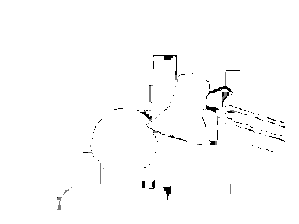
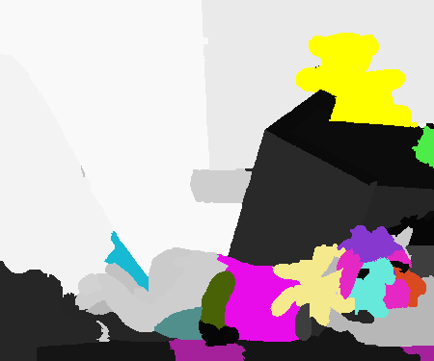
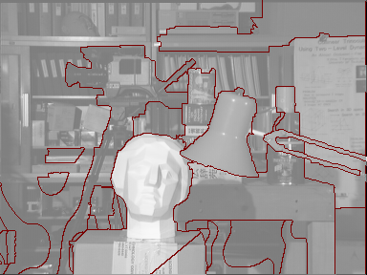
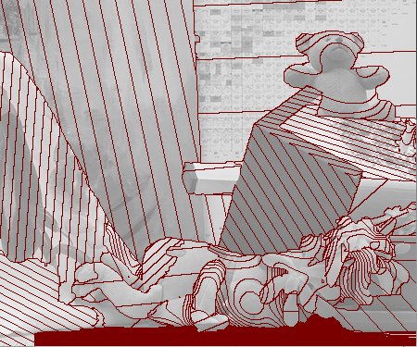
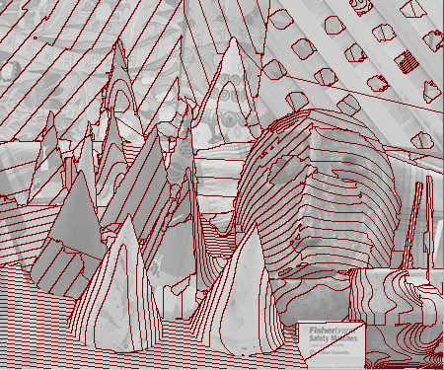
Computed disparity maps
Disparity errors > 1 pixel
Assignment of pixels to surfaces
Left images with contour lines overlaid

Slide 28
Computed disparity maps
6th rank out of ~90 submissions in the Middlebury online table.
1th rank for the complex Teddy set on all error measures.
Disparity errors > 1 pixel
Assignment of pixels to surfaces
Left images with contour lines overlaid

Slide 29
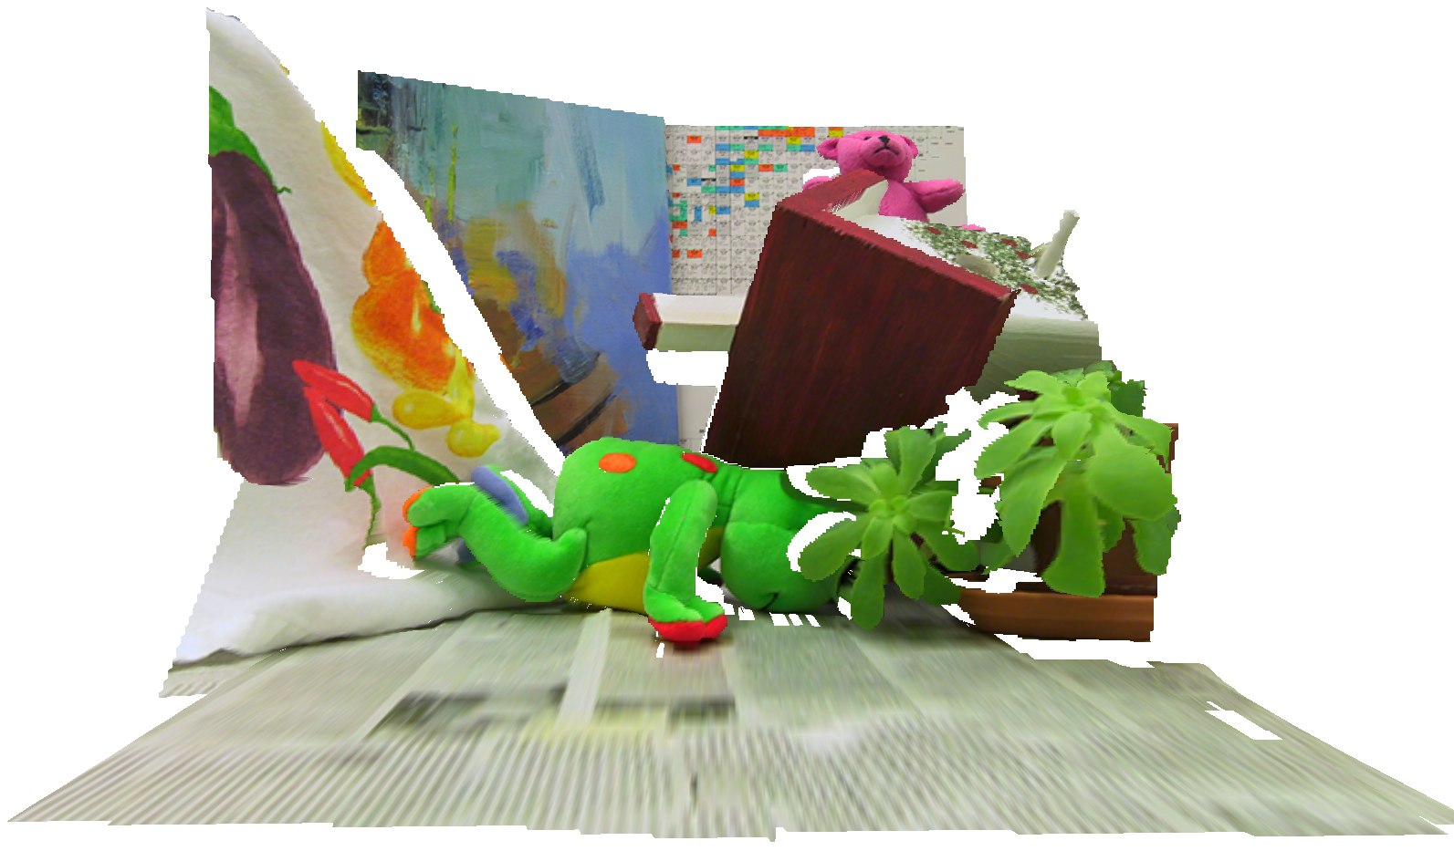

Slide 30
Conclusions
Surface-based representation is important.
Enables several important contributions:
Soft segmentation
MDL prior

