Slide 1
Does Color Really Help in Dense Stereo Matching?
Michael Bleyer¹ and Sylvie Chambon²
¹Vienna University of Technology, Austria
²Laboratoire Central des Ponts et Chaussées, Nantes, France

Slide 2
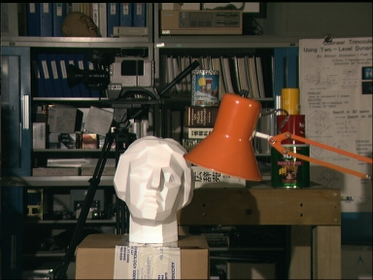
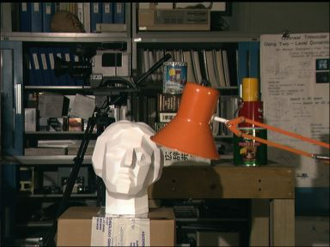
Dense Stereo Matching
(Left Image)
(Right Image)

Slide 3
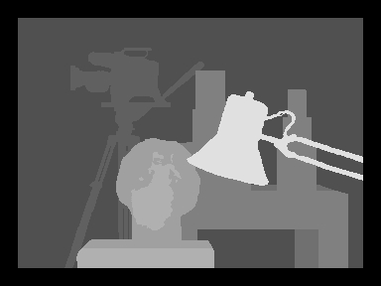
Dense Stereo Matching
(Left Image)
(Right Image)
(Disparity Map)

Slide 4
Dense Stereo Matching
Key question of this paper:
Can we improve matching performance by using color information?
(Left Image)
(Right Image)
(Disparity Map)

Slide 5
Why Should Color Help?
(Left Image)
(Right Image)

Slide 6
Why Should Color Help?
(Left Image)
(Right Image)
Conversion to grey-scale

Slide 7
Why Should Color Help?
?
(Left Image)
(Right Image)
Conversion to grey-scale

Slide 8
Why Should Color Help?
?
Color reduces the ambiguity problem
(Left Image)
(Right Image)
Conversion to grey-scale

Slide 9
Contradicting Statements in the Literature
Several previous color evaluation studies:
In the context of local methods:
[Chambon, IJRA05], [Mühlmann, IJCV02], …
In the context of global methods:
[Bleyer, ISPRS08]
In the context of radiometric insensitive match measures (local and global methods)
[Hirschmüller, PAMI09]
Color helps
Color helps
Color does not help

Slide 10
Contradicting Statements in the Literature
Several previous color evaluation studies:
In the context of local methods:
[Chambon, IJRA05], [Mühlmann, IJCV02], …
In the context of global methods:
[Bleyer, ISPRS08]
In the context of radiometric insensitive match measures (local and global methods)
[Hirschmüller, PAMI09]
Color helps
Goal of our benchmark: Find out who is right
Color helps
Color does not help

Slide 11
Remainder of this Talk
Benchmark design:
Competing energy functions
Dissimilarity functions
Color spaces
Performance metrics
Benchmark results:
Standard dissimilarity functions
Radiometric insensitive functions

Slide 12
Energy Function
Quality of disparity map D measured by a standard energy function:
Data Term: - Measures pixel dissimilarities - Evaluated in this paper
Smoothness Term: - Measures amount of spatial smoothness
Notes:
For each pixel p of the left view, we measure the color dissimilarity between p and ist matching point in the right view.

Slide 13
Energy Function
Quality of disparity map D measured by a standard energy function:
- Modified Potts Model:
- P1 := P2 / 3
- P2 is tuned individually for each energy function
0 if dp = dq
P1 if | dp - dq | = 1
P2 if | dp - dq | > 1

Slide 14
Energy Function
Quality of disparity map D measured by a standard energy function:
Various competing implementations:
4 dissimilarity functions
9 color spaces
Leads to 4 * 9 = 36 competing energy functions

Slide 15
Dissimilarity Functions
Absolute difference of colors
Cannot handle radiometric distortions
Pixel-based
Mutual Information (MI)
Handles radiometric distortions
Pixel-based
Zero mean Normalized Cross-Correlation (NCC)
Handles radiometric distortions
Window-based
Census
Handles radiometric distortions
Window-based

Slide 16
Dissimilarity Functions
Absolute difference of colors
Cannot handle radiometric distortions
Pixel-based
Mutual Information (MI)
Handles radiometric distortions
Pixel-based
Zero mean Normalized Cross-Correlation (NCC)
Handles radiometric distortions
Window-based
Census
Handles radiometric distortions
Window-based
We incorporate color by - Computing the dissimilarity function individually for each color channel - Summing up the values over the 3 channels

Slide 17
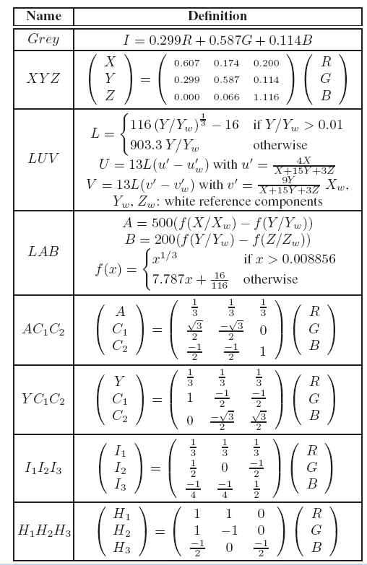
Color Spaces
Primary systems:
RGB, XYZ;
Luminance-chrominance systems:
LUV, LAB, AC₁C₂, YC₁C₂;
Statistical independent component systems:
I₁I₂I₃, H₁H₂H₃;
Use of intensity values only:
Grey;
(Conversion from RGB to other color spaces)

Slide 18
Energy Minimization
Accomplished via Dynamic Programming (DP)
DP is performed on simple tree structures [Bleyer,VISAPP09]:
Trees contain horizontal and vertical smoothness edges (scanline streaking problem)
Simple method for occlusion handling

Slide 19
Error Metrics
3 error metrics to evaluate the quality of a disparity map:
Percentage of wrong pixels in all regions
Percentage of wrong pixels in radiometric distorted regions
Percentage of wrong pixels in radiometric clean regions
Definitions:
Wrong pixel means absolute disparity error > 1 (analogously to Middlebury)
Radiometric distorted means a pixel has different intensity/color in left and right images
When I say average error I mean the average error computed over all 30 test pairs

Slide 20
Error Metrics
3 error metrics to evaluate the quality of a disparity map:
Percentage of wrong pixels in all regions
Percentage of wrong pixels in radiometric distorted regions
Percentage of wrong pixels in radiometric clean regions
Definitions:
Wrong pixel means absolute disparity error > 1 (analogously to Middlebury)
Radiometric distorted means a pixel has different intensity/color in left and right images
When I say average error I mean the average error computed over all 30 test pairs
How can we extract radiometric distorted regions?

Slide 21
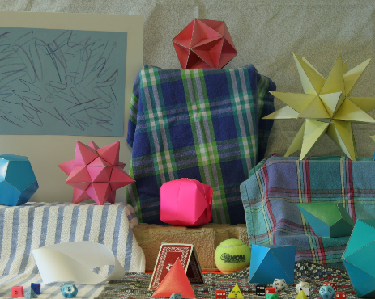
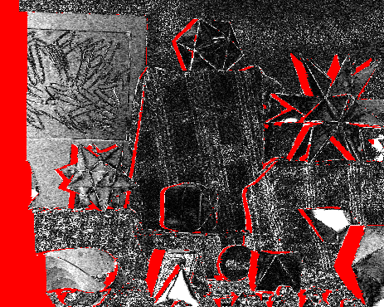
Extraction of Radiometric Affected Regions
Compute absolute intensity difference between corresponding pixels (Correct correspondences known from ground truth disparity data)
Moebius left image (new Middlebury set)
Ground truth data costs (bright pixels have high pixel dissimilarity)

Slide 22
Extraction of Radiometric Affected Regions
Compute absolute intensity difference between corresponding pixels (Correct correspondences known from ground truth disparity data)
Moebius left image (new Middlebury set)
Ground truth data costs (bright pixels have high pixel dissimilarity)

Slide 23
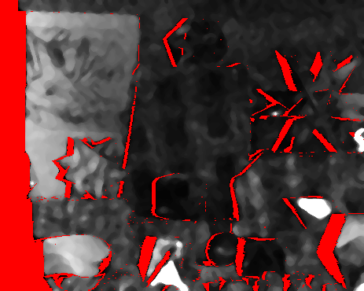
Extraction of Radiometric Affected Regions
Compute absolute intensity difference between corresponding pixels (Correct correspondences known from ground truth disparity data)
Median Filter
Ground truth data costs
Radiometric distorted regions

Slide 24
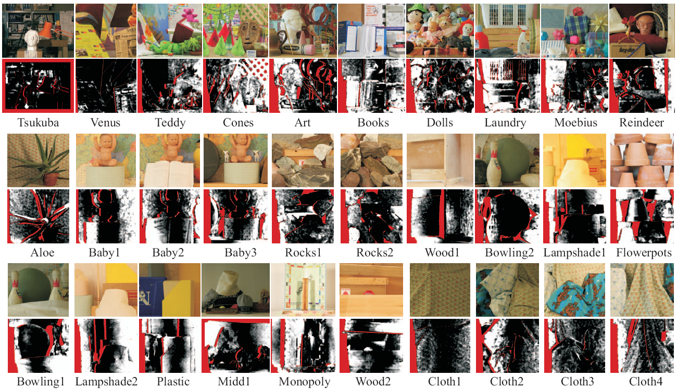
Test Set
30 test pairs (Middlebury set) with corresponding images showing radiometic distortions

Slide 25
Results

Slide 26
Absolute Differences as Dissimilarity Function
Grey-scale matching nearly always performs worst.
LUV performs better than RGB
Identical to the results of [Bleyer,ISPR08]

Slide 27
Absolute Differences as Dissimilarity Function
So using color is a good thing?
Well, that is not the whole story.
Grey-scale matching nearly always performs worst.
LUV performs better than RGB
Identical to the results of [Bleyer,ISPR08]

Slide 28
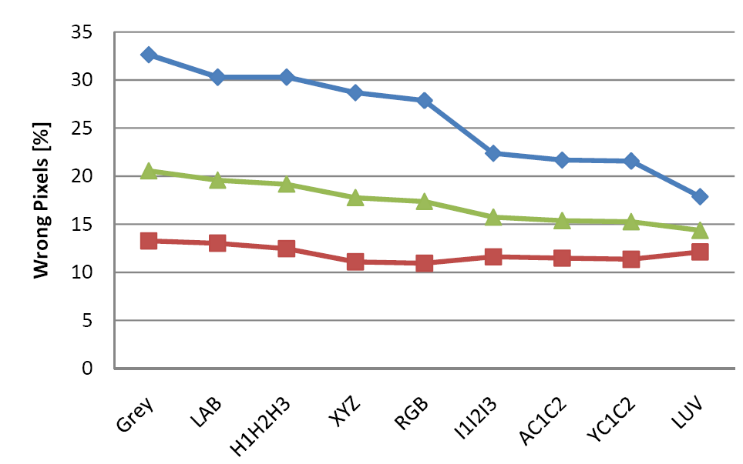
Where Does Color Help?
Avg. error radiometric distorted regions
Color effectively improves performance in radiometric distorted regions.

Slide 29
Where Does Color Help?
Avg. error radiometric clean regions
Color effectively improves performance in radiometric distorted regions.
Color makes little difference in radiometric clean regions.

Slide 30
Where Does Color Help?
Avg. error all regions
Color effectively improves performance in radiometric distorted regions.
Color makes little difference in radiometric clean regions.
The overall improvement is largely due to considerably improved performance in radiometric distorted regions.

Slide 31
Where Does Color Help?
Avg. error all regions
If color mostly helps in radiometric distorted regions, why not directly using a radiometric insensitive match measure?
Color effectively improves performance in radiometric distorted regions.
Color makes little difference in radiometric clean regions.
The overall improvement is largely due to considerably improved performance in radiometric distorted regions.

Slide 32
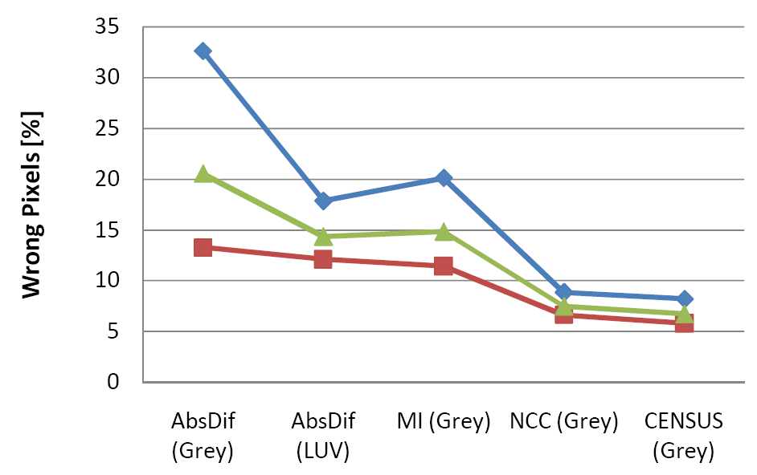
Why Not Directly Using a Radiometric Insensitive Measure?
Avg. error radiometric distorted regions
ZNCC and Census considerably improve performance in radiometric distorted regions.
They are more effective than color in this respect

Slide 33
Why Not Directly Using a Radiometric Insensitive Measure?
Avg. error radiometric clean regions
ZNCC and Census considerably improve performance in radiometric distorted regions.
They are more effective than color in this respect
They even improve performance in radiometric clean regions.

Slide 34
Why Not Directly Using a Radiometric Insensitive Measure?
Avg. error all regions
ZNCC and Census considerably improve performance in radiometric distorted regions.
They are more effective than color in this respect
They even improve performance in radiometric clean regions.
ZNCC and Census improve the overall performance considerably
The overall error drops from 20.5% [Absdif (Grey)] to 6.7% [Census (Grey)] (!)

Slide 35
Why Not Directly Using a Radiometric Insensitive Measure?
Avg. error all regions
Can we get additional improvement by incorporating color into ZNCC and Census?
ZNCC and Census considerably improve performance in radiometric distorted regions.
They are more effective than color in this respect
They even improve performance in radiometric clean regions.
ZNCC and Census improve the overall performance considerably
The overall error drops from 20.5% [Absdif (Grey)] to 6.7% [Census (Grey)] (!)

Slide 36
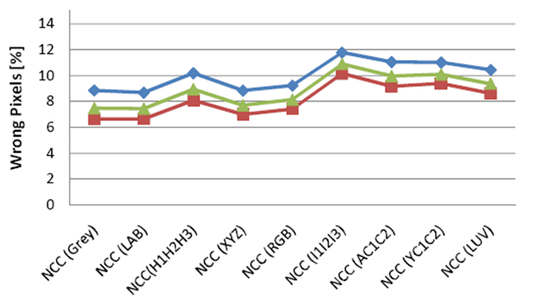
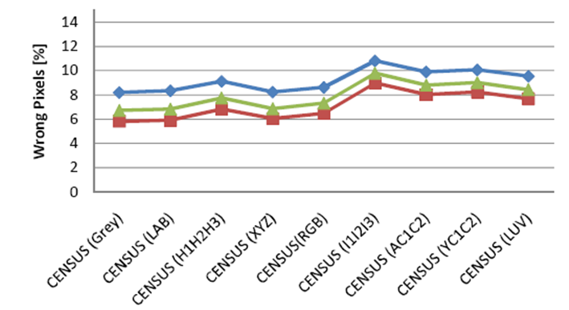
Using Color with Radiometric Insensitive Measures
Seems to be a bad idea:
Color even worsens results
Why is it?
Increased robustness of color in radiometric regions is not important anymore
NCC and CENSUS do a better job
You practically do not lose texture when deleting color
Intensity is probably more robustly captured by nowadays cameras (less noise in the intensity channel)

Slide 37
Using Color with Radiometric Insensitive Measures
We suggest:
Use radiometric insensitive match measures
Do not use color
Seems to be a bad idea:
Color even worsens results
Why is it?
Increased robustness of color in radiometric regions is not important anymore
NCC and CENSUS do a better job
You practically do not lose texture when deleting color
Intensity is probably more robustly captured by nowadays cameras (less noise in the intensity channel)

Slide 38
Conclusions
Major argument for color is the increased robustness to radiometric distortions.
This benefit is low considering that ZNCC and Census do a considerably better job in distorted regions.
Do not use color in conjunction with ZNCC or Census.

Slide 39
Future work
Check whether results generalize to other image sets
Currently only Middlebury used
Test other optimization algorithms
We have done some preliminary tests with α-expansion and local optimization that confirm our results (not in the paper)
Use other energy models
Second-order smoothness
More dissimilarity measures
Incorporate segmentation-based aggregation schemes
Another step on the way to an “optimal” stereo data term

Slide 40
References
[Bleyer,ISPRS08] M. Bleyer, S. Chambon, U. Poppe, M. Gelautz, Evaluation of Different Methods for Using Colour Information in Global Stereo Matching, Int. Archives of the ISPRS, 2008.
[Chambon,IJRA05] S. Chambon, A. Crouzil, Colour Correlation-Based Matching, Int. Journal for Robotics and Automation, vol. 20, no. 2, 2005.
[Mühlmann,IJCV02] K. Mühlmann, D. Maier, J. Hesser, R. Männer. Calculating Dense Disparity Maps from Color Stereo Images, an Efficient Implementation, IJCV, vol. 47, no. 1, 2002.
[Hirschmueller,PAMI09] H. Hirschmueller, D. Scharstein, Evaluation of Stereo Matching Costs on Images with Radiometric Differences, PAMI, vol. 31, no. 9, 2009.

